Slide 2
Purchase Card Program Goods and Services Training
Presenters:
Brian Herrera
Lupe Gudino
March 26, 2025

Slide 3
Agenda
P-Card Overview (Brian H.)
Roles and Responsibilities
Policies/Restrictions
CardQuest
Requesting Changes
Reconciliation Procedures (Lupe G.)
Accessing CardQuest and User Preferences
Creating a Goods and Services Report
Reconciling P-Card Transactions

Slide 4
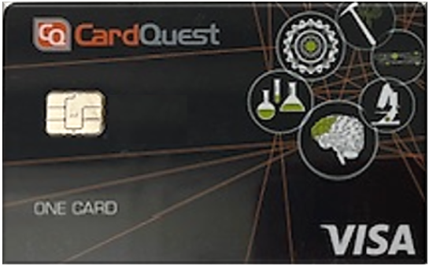
What is a P-Card?
Issued U.S. Bank Visa Credit Card
Sixteen-digit card number (first 8 unique to Caltech)
Cardholder’s name and Caltech showcase on back card**
Used to purchase items for the use and benefit of Caltech
Merchants paid by Visa in 48 hours
Works the same as a personal card except Caltech pays the monthly bill: corporate liability

Slide 5
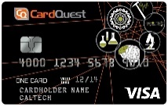
What are the Benefits?
Is Amazon Business Prime free?
Fast and convenient method of payment
Accepted by many merchant (must take Visa as payment)
Around the clock U.S. Bank Customer Service
Built-in limits and controls that block unauthorized spend
Robust cloud-based travel and expense management system (CardQuest)
Cardholders can join P-Card’s Exclusive Amazon Business Prime account.

Slide 6
Roles of Program Participants
Role | Responsibilities
Cardholder | Only one who can make purchases Will verify and retain receipt for conformance May reconcile Resolve disputes with the merchant
Expense Delegate | Allocate charges and submits reports for approval Retains documentation Assists in disputes with merchants
Expense Approver | Reviews Request for P-Card applications Determines spending limits Review and electronically approve expense report

Slide 7
P- Card Policies
Guidelines
The P-Card Team and Auditors conduct Periodic Audits. Violations of the policies and procedures may result in cardholder retraining and/or card revocation
Fraudulent misuse will result in disciplinary action
All purchases must be for the use and benefit of Caltech
Protect card information
Keep up to date with P-Card account
P-Card G&S Only ($3,500/$15,000)
P-Card w/ Travel ($5,000/$20,000)
Adhere to Reconciliation Deadline & Restrictions
Receipts in a foreign language, CQ Foreign Receipt Required
Justification Form Required for purchases exceeding $10,000.00

Slide 8
Access Online User Profile (Optional)
View Statements
Setup Fraud Alerts
See available credit
View information about declined transactions
Dispute transactions
View posted transactions

Slide 9
What are the restrictions?
Animals
Weapons/Ammunition
Controlled Substances
Radioactive Materials
Caltech SmartCash
Donations
Personal Purchases
Splitting Orders
Fuel for Personal Vehicles
P2P Payments Applications
Sole Proprietor / Independent Contractors
Leases Long-Term Rentals
Capitalized Equipment
Relocation/Moving Expenses
Supplier Contracts/Terms & Conditions / Quotes
Debarred Businesses (sam.gov)

Slide 10
NDAA 889 Federal Regulation 1. Section 889 of the John S. McCain National Defense Authorization Act prohibits government contractors from providing the federal government with telecommunications or video surveillance equipment, systems, or services (or an essential component thereof) produced or provided by five Chinese companies are: * Huawei Technologies Company * ZTE Corporation * Hytera Communications Corporation * Hangzhou Hikvision Digital Technology Company * Dahua Technology Company 2. Separately, Section 889 prohibits government contractors from using these prohibited items or services, regardless of whether they are used in the performance of work under a federal contract. An updated list of these five companies’ subsidiaries can be found here. (Note: Caltech credentials are required for access)

Slide 11
NDAA 889 Federal Regulation (cont.) As a government contractor (recipient of federal funds), Caltech must comply with Section 889 across all transactions. Therefore, if you purchase goods or services on behalf of Caltech, do no purchase any equipment, system service, or component thereof produced by or provided by these companies, their subsidiaries, or their affiliates. Section 889 provides narrow exceptions. If you believe that you require an exemption from Section 889’s prohibitions, consult with the Director of Procurement Services prior to purchasing the prohibited item or service. For additional information, visit Caltech’s NDAA 889 webpage: https://researchcompliance.caltech.edu/export/national-defense-authorization-act-ndaa-section-889

Slide 12
Additional Federally Imposed Restrictions
Kaspersky Lab (NDAA Section 1634)
TikTok/ByteDance/Lark
The Federal Acquisition Regulation (FAR) now prohibits government contracting for hardware, software, and services developed or provided by Kaspersky Lab and Other Covered Entities.
Reference FAR 52.204-24, 25 & 26
TikTok social networking service or any successor application or service developed or provided by Byte Dance Limited or any entity owned by them
Reference FAR 52.204-27

Slide 13
Gifts and Gift Cards Policy
Gift Cards
Per IRC Section 132(a)4, gift cards purchased for employees and students are considered taxable income. Gift card purchases for students and employees is tax reportable to the Payroll office regardless of the amount
Tangible Gifts
Per IRC 132 (e) Reg. 1.132-6 (b), Caltech has determined that tangible gifts with a value of $75 and greater is tax reportable to the student or employee recipient and shall be reported to the Payroll office.
Expense Type for Tangible Gifts
CIT Employee or Student Recipient (Less Than $75.00) | CIT Employee or Student Recipient (Greater Than $75.00) | Non-CIT Employee (Any Value)
Goods Simple | Other-Gift/Awards | Goods Simple
Expense Type for Gift Cards
CIT Employee or Student Recipient (Any Value) | Non-CIT Employee (Any Value)
Other-Gift/Awards | Goods Simple

Slide 14
Lost/Stolen Card
Lost or Stolen P-Card | Contact US Bank Customer Service 1-800-344-5696 Contact a P-Card Administrator
Intercepted P-Card | Contact US Bank Customer Service 1-800-344-5696 Contact a P-Card Administrator

Slide 15
Disputing A Charge
Resolving Disputes
Time limit 60 days from the transaction date
Cardholder or reconciler to work with merchant first
Disputes can be submitted 3 ways: US Bank Access Online Contact US Bank Customer Service Contact a P-Card Administrator

Slide 16
Fraud
Fraud cases should be initiated over the phone (1-800-344-5696). Please do not use mail, fax or online processes to initiate fraud.
Fraud must be reported within 60 days of the transaction date
You will be asked to close your card.
Provisional credit will be applied to the new account
The cardholder will be sent a Statement of Fraud to confirm that they did not authorize those transactions
If the signed Statement of Fraud is not received by the bank, the new account will have the charges reapplied and the cardholder will be liable to pay for them
The Fraud and Dispute Process document is available upon request explaining the processes in more detail.

Slide 17
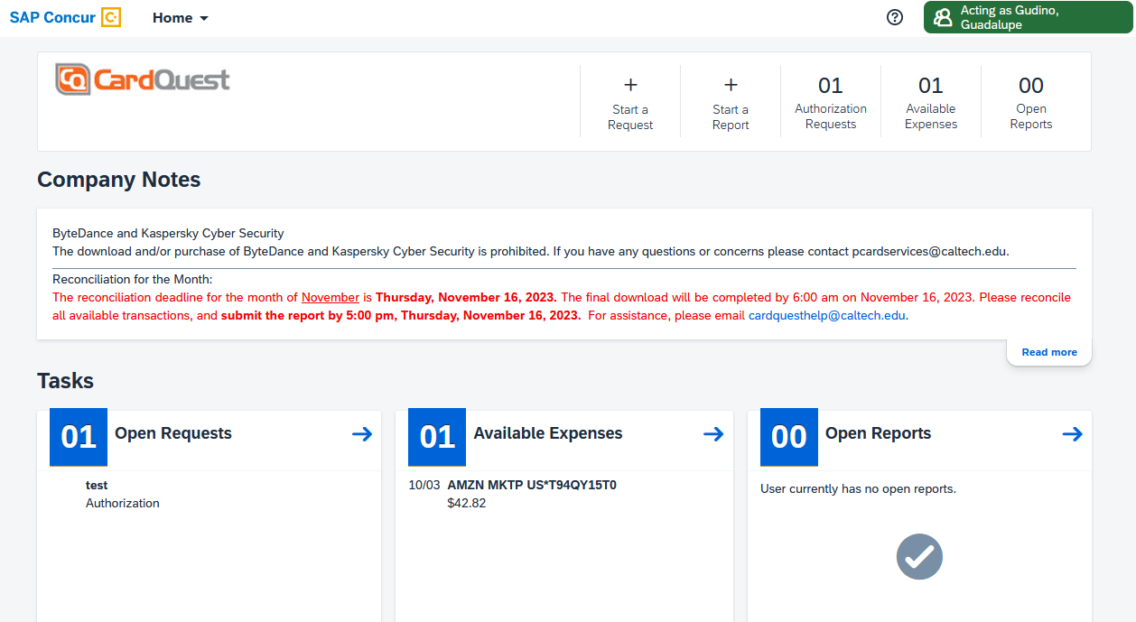
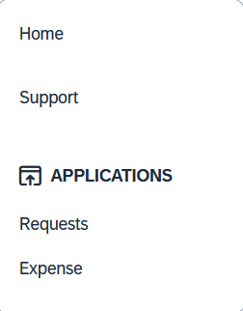
CardQuest Landing Page

Slide 18
What is CardQuest and how does it work?
Daily transactions downloaded electronically from Visa into CardQuest
Billing Cycle (begins on 16th & ends on 15th of every month)
Email notifications/reminders sent when there are transactions to reconcile
Create report, move charges
Enter item description and business purpose, and sales tax if applicable
Allocate to PTAs
Submit monthly transaction reports online with e-receipts for approval within system
Send paper receipts and invoices to P-Card Services per FAR Audit Regulation (special envelopes will be provided)

Slide 19
Audit Rules
Built in audit rules to ensure expenses follow P-Card Policies
Goods & Services
Personal charges
Receipt required for all transactions
Purchases over 10K (justification form required)
Duplicate transaction
Gift cards (reportable to Payroll)

Slide 20
Tax Issues
Any sales tax that is billed must be entered in a separate tax field: it is a required field
If the sales tax box is not filled in, and both the PTA and transaction are taxable, tax will be accrued
If a tax exemption certificate is required, obtain from the P-Card Administrator.

Slide 21
Submitting Reports
Report | Frequency of Submission/Oracle Interface
Goods and Services Expense Reports | Once a month (end of the billing cycle)
Accruals – Expense amounts not submitted and interfaced to Oracle will be accrued in Cognos nightly only after users allocate card charges to PTAs and save. Allocate to PTA often; Submit as stated above.

Slide 22
Reconciliation Policy
Reconciliation violation
Reconciliations (past 60 days) may result in some or all of the following actions: Notice to authorizer Retraining Suspension of P-Card (until reports are submitted and approved) P-card revocation
Reconciliation deadline may only be extended with the approval of the Director of Procurement Services within 24 hours of the reconciliation deadline.

Slide 23
Concur's CardQuest Request Module
Request for P-Card*
Declining Balance Card Request*
Low Limit Card Request*
Non-Cardholder Access Request*
P-Card Change Limit Request*
Expense Approver Update*
Request to Cancel or Suspend P-Card
Delegate Request

Slide 24
For The Products You Need, We Encourage You to Find Them on Amazon Business!
From Janitorial to IT to those hard to find items - Amazon Business stocks millions of education products and they’re adding more education items and suppliers everyday. Whether it’s a 3D printer, classroom supplies, or a lab beaker, we encourage you to find it on Amazon Business.
Exclusive access to millions of additional products, sellers, and discounted pricing not available on Amazon.com
Enhanced reporting to easily track and manage spend
Now integrated with Concur, which will enable E-Receipts for all Amazon Business purchases. E-Receipts will flow directly into the cardholder’s Available Receipt queue IF user has a verified email address within CardQuest.
Save time finding and purchasing supplies with Amazon Business’s improved category and search functionality for EDU specific needs

Slide 25
Important Contact Information
Brian Herrera: 626-395-8470
Lupe Gudino: 626-395-6235
Michelle Lampe: 626-395-6257
pcardservices@caltech.edu
cardquesthelp@caltech.edu

