Slide 1
Notes:
Elisa

Slide 2
Airgas Town Hall
September 18th, 2024
Notes:
Elisa

Slide 3
Agenda
Introductions
Caltech Fun Fact
Airgas Overview
Airgas – Caltech Cylinder Audit and Lease Program (Airgas)
Ways to Dispute a Lease Invoice
Airgas/TechMart
Audit Team
Q & A Session
Notes:
Elisa

Slide 4
Introductions
Caltech
Monica Marquez, Director, Purchasing Services
Elisa Brink, Contracting Manager
Airgas
Jessica Spencer, District Manager
Benjamin Gutierrez, Account Manager
Ananya Kepper, Specialty Gas Representative
Luis Cervantes, Cylinder Control Manager
Brian McLaughlin, Cylinder Control
Jill Johnson, Cylinder Control
Notes:
Start off Elisa

Slide 5
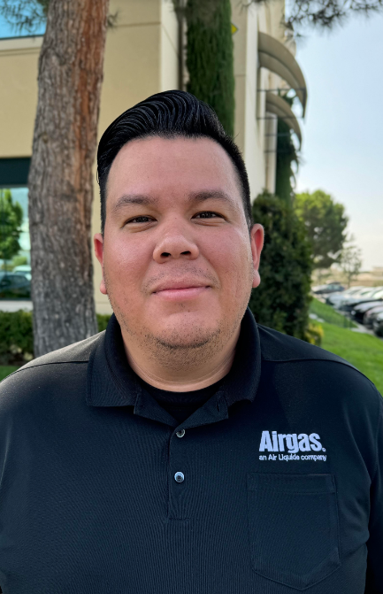
Ben Gutierrez
Ben has been with Airgas 6 years
with experience in both Medical and
Industrial markets.
Contact Info:
Phone: 626-681-7335
Email: Benjamin.Gutierrez@airgas.com
Notes:
Ben

Slide 6
Ananya Kepper
Specialty Gas Specialist
Ananya Kepper has her BS in Chemistry from UCSB and has been with Airgas for 1 year.
Contact Info:
Phone: (562) 625-3433
Email: ananya.kepper@airgas.com
Notes:
Ananya

Slide 7
Caltech Fun Fact
The Thinker:
Robert Andrews Millikan the “thinker” of Caltech’s founding fathers, won Caltech’s first ever Nobel Prize in 1926 for his work on the photoelectric effect and measurement of an elementary charge
Notes:
Ananya

Slide 8
Caltech Cylinder Audit and Lease Program
Jessica Spencer
District Manager
Account Manager
Benjamin Gutierrez
Specialty Gas Representative
Ananya Kepper
Notes:
Ben

Slide 9
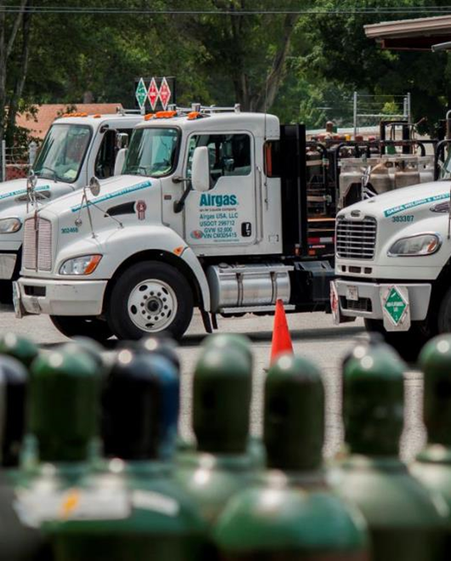
Airgas Overview- Unparalleled Distribution Platform
Largest Gases Platform in the U.S.
Leader in the U.S. gas market
Leading position in U.S. packaged industrial, medical, and specialty gas market
One of the largest producers of bulk atmospheric gases
Leading U.S distributor of welding and safety products and services
Cylinder plant operations: 344 plants nationwide
~1.2M industrial cylinders filled per month
11 Acetylene Plants
~100k Acetylene cylinders filled per month
Notes:
Ben

Slide 10
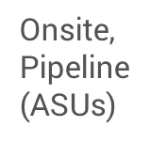
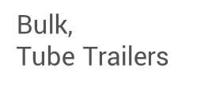
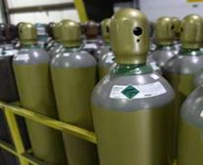
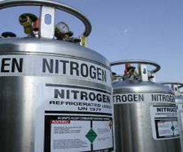
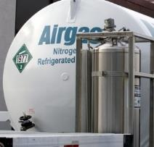
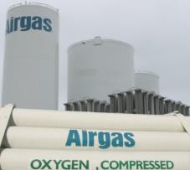
Airgas Overview- Full Range of Gas Supply Modes
Enables our customers to optimize their production processes and reduce total costs
Packaged Gases
Notes:
Ben

Slide 11
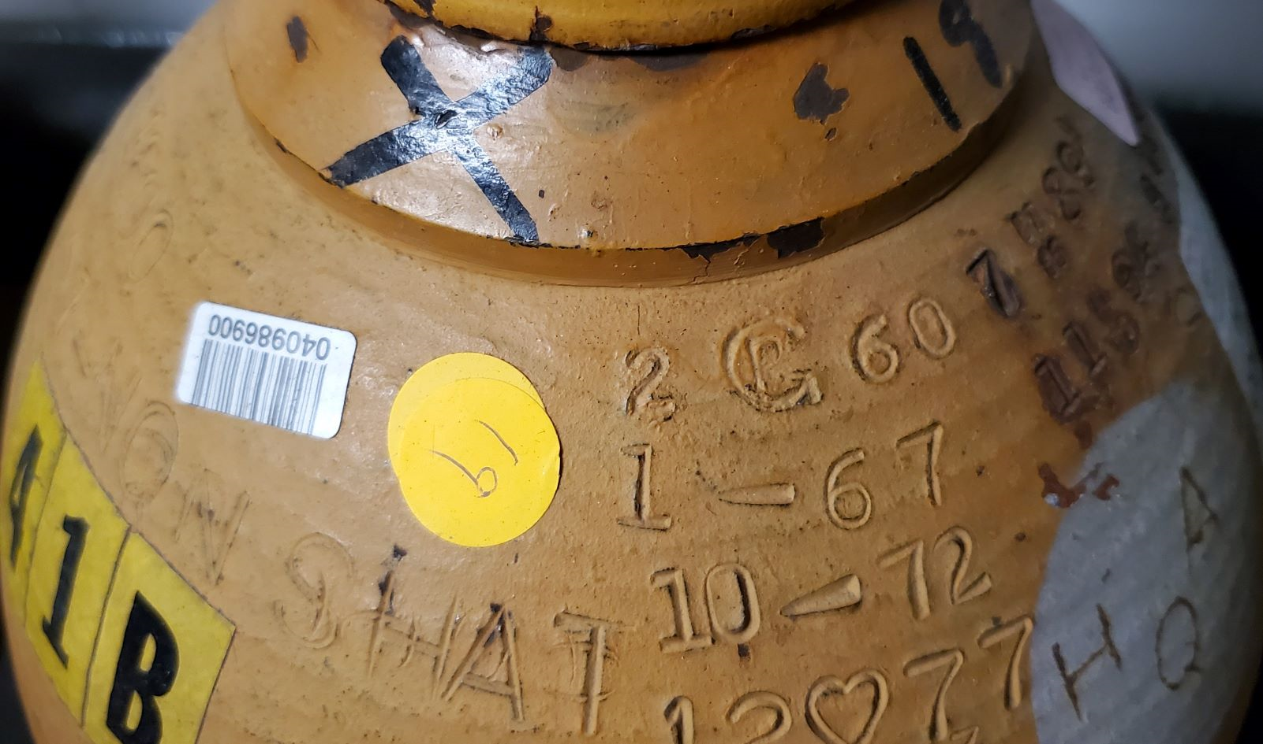
Examples of Airgas-owned cylinders vs CIT-owned
Airgas Owned
Caltech Owned
Look for an orange sticker
Notes:
Ben

Slide 12
Cylinder Audit Process
Airgas will release the lease invoices on October 1st, 2024
Caltech end users have until October 31st, 2024, to pay these invoices.
If paid by the due date no physical audit will be conducted for the associated Ship-To
If not paid by the due date and no dispute is filed, past-due accounts may be put on credit hold
Anticipated Audit Date
February 18th - 20th, 2025 Day 3 on hold if needed.
Caltech Purchasing Services will reach out to Ship-To Points of Contact to establish audit “appointments” and require a lab representative be present during the audit
During the Audit
Airgas team will be escorted by Caltech personnel and lab representative to enter the facility and physically record each cylinder on audit count sheets.
Caltech Ship-To Point of Contact (or lab representative) sign off on audit count sheets
Airgas reconciles the cylinder count and revises invoices accordingly
Caltech billed for counted cylinders
Ship-To Points of Contact can pay these lease invoices through a couple of methods (P-Card or TechMart). Be on the lookout next week for simple instructions from Purchasing Services
Notes:
Ananya

Slide 13
Benefits of the Airgas Lease Program
One-time yearly billing
Audits will be conducted only at labs that have discrepancies or are disputing count
Relieves lab of monthly rental bills
Unlimited inventory available
Less hassle, less paperwork, more time managed
Tracked by Airgas and Caltech facilities through barcode scanning program
By lab/by building
100% inventory accuracy
Yearly on-site inventory to ensure correct billing
Airgas and Caltech work together to perform audits on only the labs that have invoice discrepancies
Notes:
Ananya

Slide 14
Lease Rates Made Simple
Each industrial gas cylinder will be assigned an annual cost of $60.17 per year / $.16 cents per day
Each specialty gas cylinder will be assigned an annual cost of $102.09 / $.28 cents per day
Cylinder lease invoices will need to be paid by 10/31/2024, to avoid a physical audit. If original invoices are disputed, new invoices generated after the in-person audit must be paid by their due date
Invoices will be accessible via the Airgas TechMart Punch-Out
Airgas will monitor cylinder balances to ensure the amount of cylinders on hand is within 10% of the invoiced quantity
Accounts with more than a 10% increase in cylinders on hand with have their annual rates reassessed
Notes:
Ananya

Slide 15
Ways to Dispute an Invoice with Airgas
Email:
Benjamin Gutierrez, Account Manager
Ananya Kepper, Specialty Gas Specialist
Call:
Benjamin Gutierrez, Account Manager
Ananya Kepper, Specialty Gas Specialist
In Person Visit:
Benjamin and Ananya are on campus on Wednesday mornings, they will be
able to address the dispute
Notes:
Ben

Slide 16
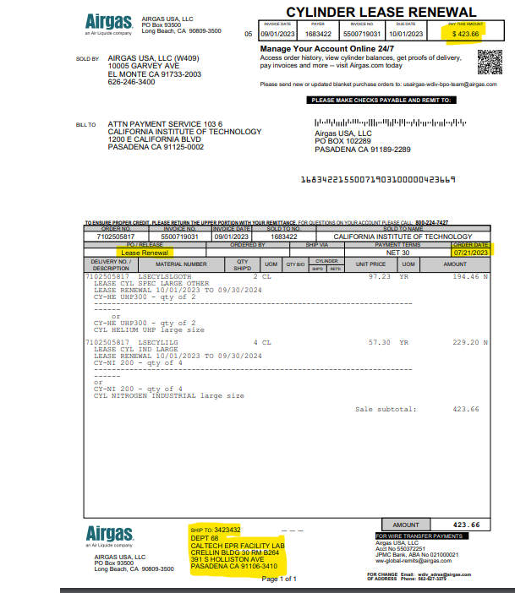
Airgas Lease Invoice Example
Amount Due
Order Date is an internal Airgas date
Cylinder Quantities
Department Code, Lab Name, and Cylinder Location Details
Notes:
Ben

Slide 17
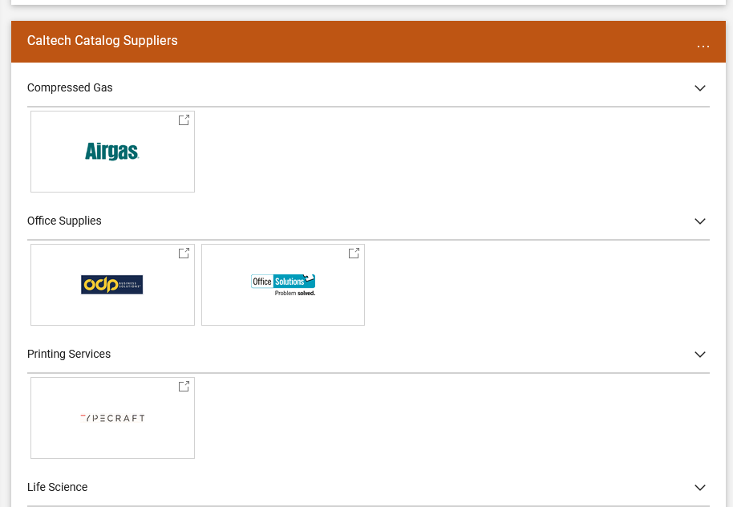
How to log into Airgas punch out to retrieve cylinder invoices
Log into TechMart, through access.caltech.edu
Click on the Airgas punchout
Notes:
Elisa

Slide 18
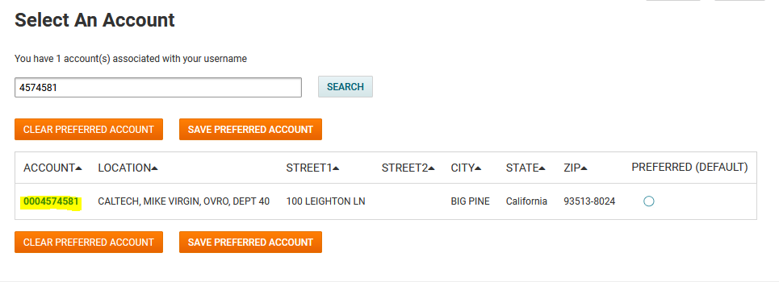
How to log into Airgas punch out to retrieve cylinder invoices, cont…
Begin with entering the Ship-To account number and then click Search
Once located, click on link to view profile for your specific account
Notes:
Elisa

Slide 19
How to log into Airgas punch out to retrieve cylinder invoices, cont…
Click on the “Invoice” link, then “Invoice History”
Notes:
Elisa

Slide 20
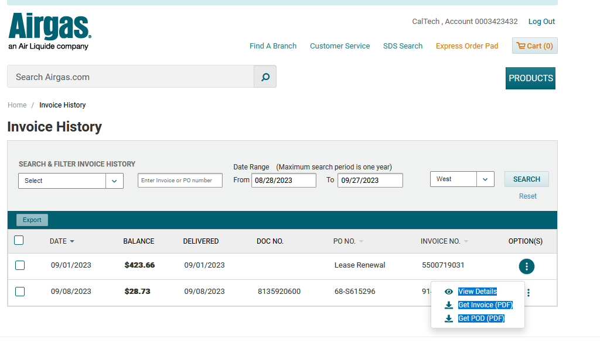
How to log into Airgas punch out to retrieve cylinder invoices, cont…
- The view below will show that Ship-To’s open invoices
- Look for the invoice that has a PO No. of “Lease Renewal”
- Click on the 3 dots next to the invoice number
- Select “Get Invoice (PDF)”
Notes:
Elisa

Slide 21
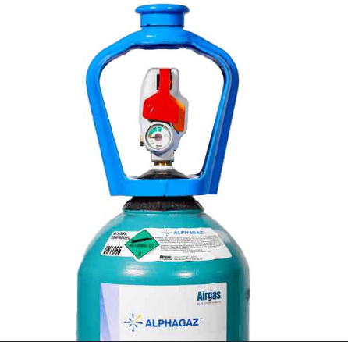
Airgas Points of Contact
Account Manager
Benjamin Gutierrez
626-681-7335
benjamin.gutierrez@airgas.com
Specialty Gas Specialist
Ananya Kepper
562-625-3433
ananya.kepper@airgas.com
District Manager
Jessica Spencer-Scothorn
(626) 712-4030
jessica.spencer@airgas.com
Credit and Collections
Felicia Perrie
(562) 766-2085
felicia.perrie@airgas.com
Notes:
Jessica

Slide 22
Audit Contact Team
Caltech Team | Airgas Team
Elisa Brink | Jessica Spencer
Monica Marquez | Luis Cervantes
Matt Brown | Jill Johnson
Chris Sierra | Ben Gutierrez
Joel Sanchez | Brian McLaughlin
Oswaldo Reategui | Ananya Kepper
Beth Streeter
Rudy Zepeda
Notes:
Elisa

Slide 23
Q & A
Session
Notes:
Elisa

