Slide 1


Slide 2




Good & Services Reconciliation Procedures

Slide 3

Agenda
CardQuest Workflow
Logging On
General Overview:
  User Profiles and Receipts
  Expense Types
    Simple vs Itemized
    Gifts & Awards
    Z-PTA Allocation
Go Live: Review Goods Simple, Itemized, Z-PTA, Gift/Awards, Adding Receipts, Review & Submit
Online Tools

Slide 4

Logging On

Slide 5

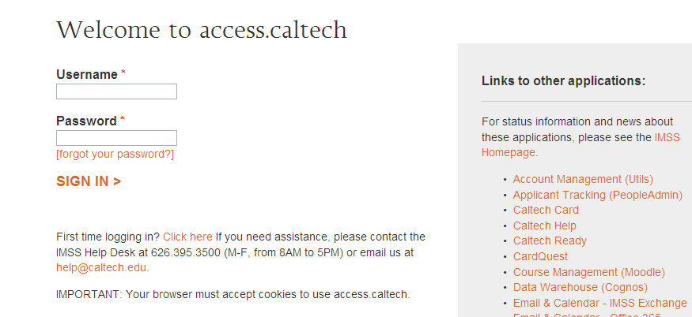
User Log In
https://access.caltech.edu
Username: access username
Password: access password

Slide 6
User Profiles
Activating Receipts

Slide 7
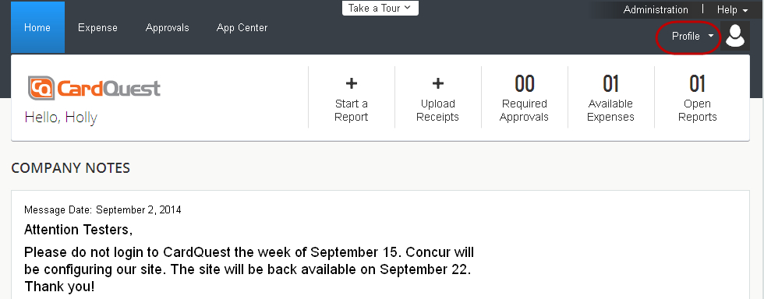
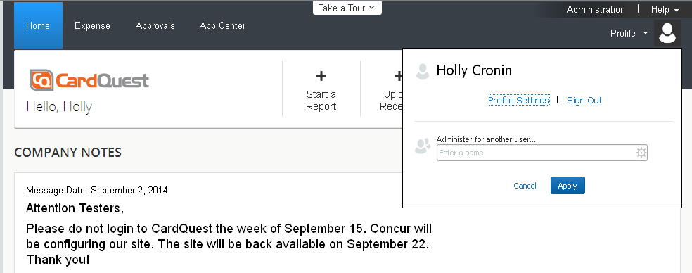
User Profile

Slide 8
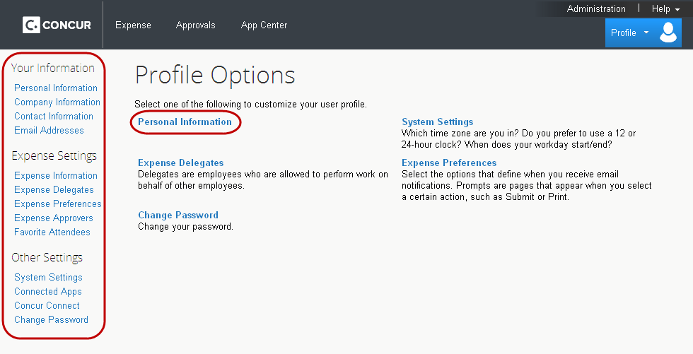
User Profile

Slide 9
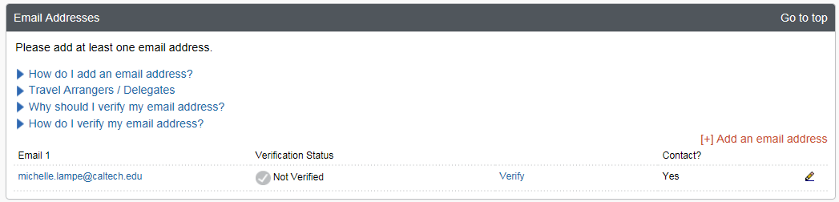
Email Verification for Receipts
Profile- Profile Settings-Your Information-Email Addresses
Click Verify
Receive email from Concur with verification code
Enter code in Profile

Slide 10
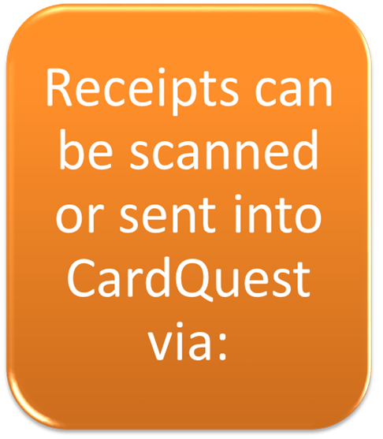
E-mail Receipts into CardQuest
Using Concur mobile
E-mail to receipts@concur.com
Upload it directly from your desktop to your Receipt Store or by clicking and dragging your receipt into your Receipt Store

Slide 11
Delegates- E-mail Receipts on behalf of the cardholder
A delegate may submit receipts on behalf of the cardholder
A delegate may submit receipts on behalf on the cardholder
Delegate e-mails receipts to receipts@concur.com with the cardholder’s email address in the subject line
The receipt will go to the cardholder’s receipt store

Slide 12
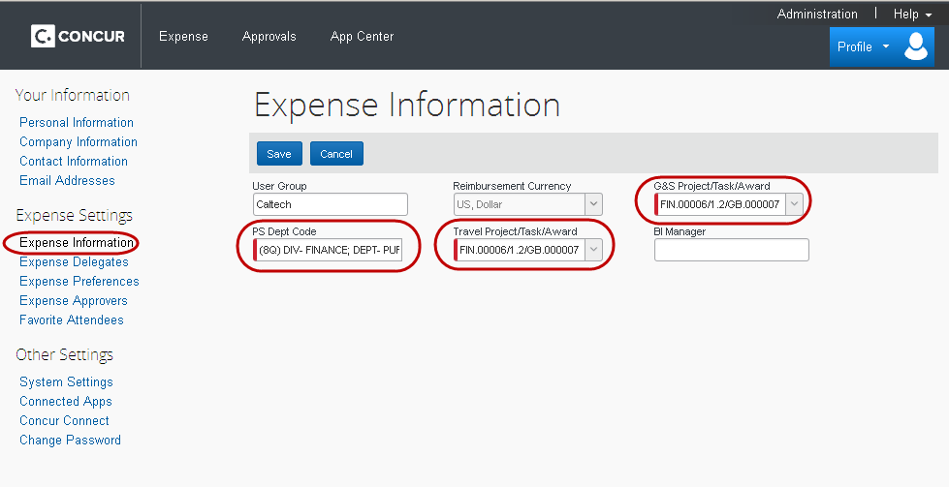
User Profile

Slide 13
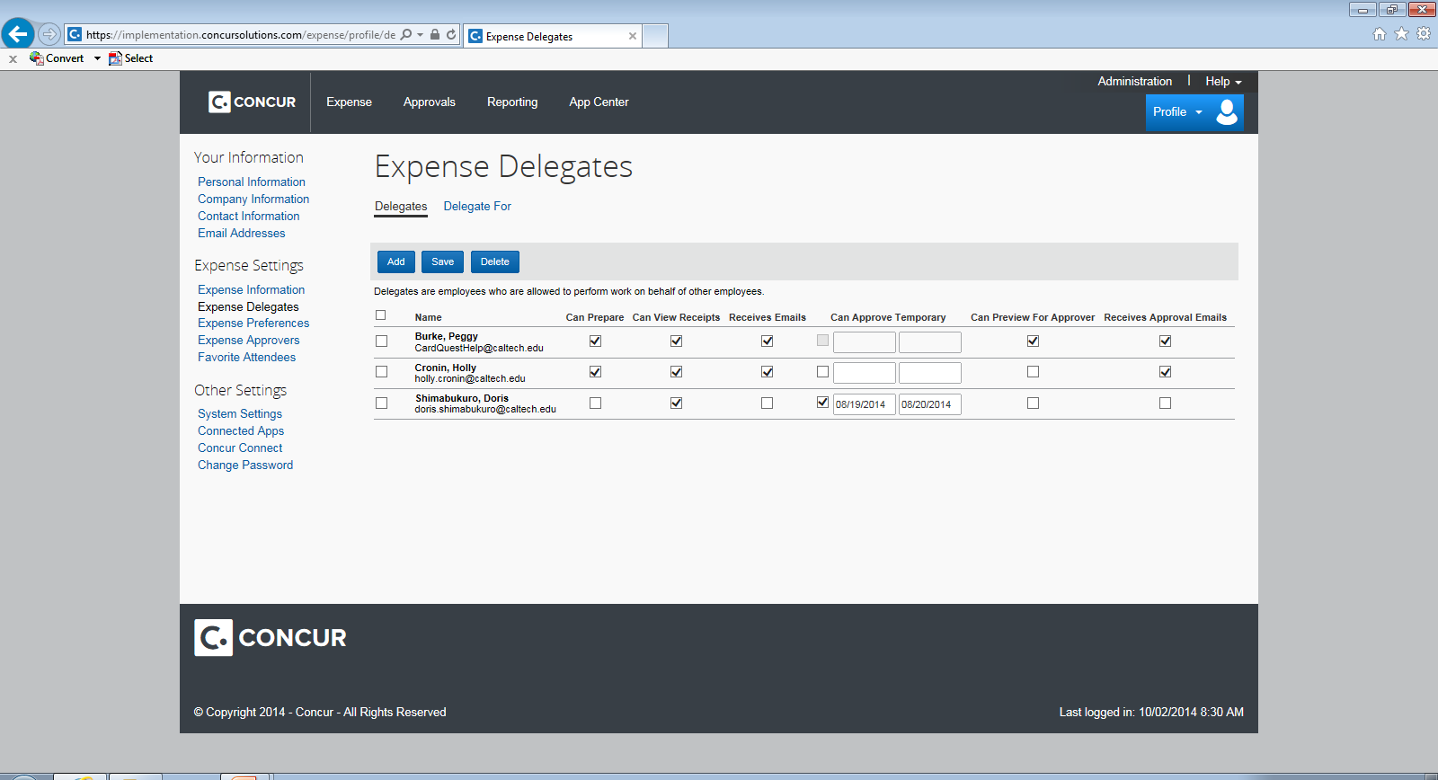
User Profile

Slide 14
Reconciling Posted Transactions
Selecting Expense Type & Expenditure Type
Simple vs Itemized
Gift & Awards

Slide 15
Reconciling a Transaction
Define
Allocate
Attach Receipt
Select Expense Category
Enter short order description and business purpose
Select PTA and Expenditure type
A receipt is required for all Goods & Services transactions (except credits/fraudulent charges)

Slide 16
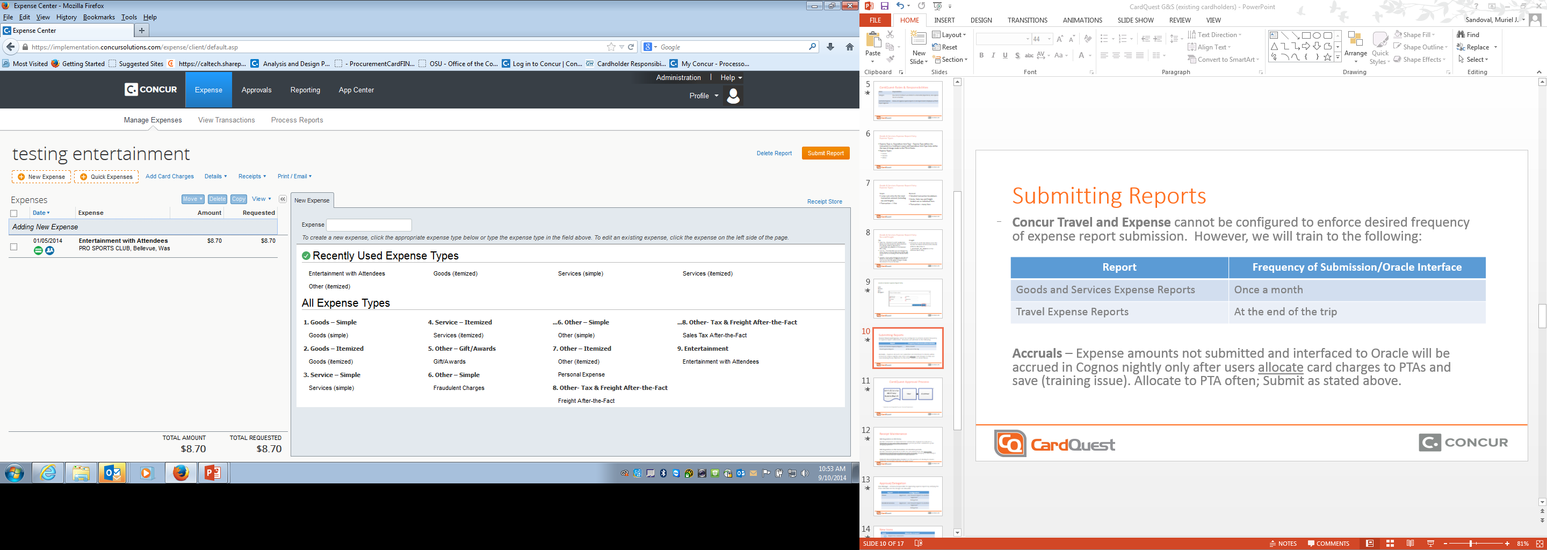
Clarification: Expense Type vs Expenditure Type
Expense Types:
Expenditure Types: Oracle categories used when allocating to a PTA ex: (Supplies – Allocable)

Slide 17
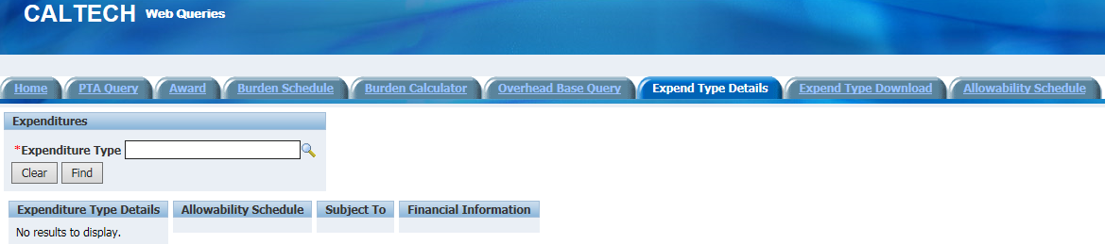
Expenditure Types
Definitions/Sponsored Awards
  http://finance.caltech.edu/documents/512-guidance_for_expenditure_types_on_sponsored_awards.pdf
  Allocable Cost
A cost is allocable to a particular award, PTA, activity, or organization if the goods or services involved are chargeable or assignable to that award, PTA, activity, or organization in accordance with relative benefits received. In order to be allocable, a cost must meet the following requirements: (1) Be necessary to the overall operations of the non-Federal entity and assignable in part to one or more award, PTA, activity, or organization consistent with the cost principals in subpart E of 2 CFR 200; (2) be incurred specifically for the award(s) or costs objective(s); and (3) if the cost benefits more than one award or activity then the cost must be distributed to the benefitting awards or activities in proportions that may be approximated using reasonable methods.
Access.caltech
  Financial Queries

Slide 18
Good & Services Expense Report Entry: Expense Type
Simple
Itemized
Detailed transaction breakdown.
Items, Sales tax and freight broken out as individual lines.
Transaction = many lines
Lump sum entry for the total transaction amount (including tax and freight).
Transaction = 1 line

Slide 19
Now let’s Go Live and apply it all…
https://www.caltech.edu/

Slide 20
Z-PTA Allocation (Dummy PTA)
Used when Itemizing an expense with Goods, Tax/Freight
TAX
FREIGHT
Sales Tax - Prorated to each taxable item line(s) once the invoice has been interface into Oracle. (PTA for allocation is Z_ALLOCATE_IN_ORACLE-Z-Z for itemized lines only)
Use Tax – if an item line was not charged tax (none shown on the receipt) then Oracle will accrue the tax according to the Oracle E-BTax rules.
Caution: if you were charged tax and did not break out the amount, it will be accrued as Use tax and the PTA will be charged double the amount of tax on the item.
Prorated to each item line(s) once the invoice has been interface into Oracle. (PTA for allocation is Z_ALLOCATE_IN_ORACLE-Z-Z for itemized lines only)

Slide 21


