Slide 1


Slide 2




Good & Services Reconciliation Procedures

Slide 3

We will go over..
Logging On
User Profiles
Reconciling Key Points
Define
Allocate
Receipts
Online Tools

Slide 4
Logging On

Slide 5





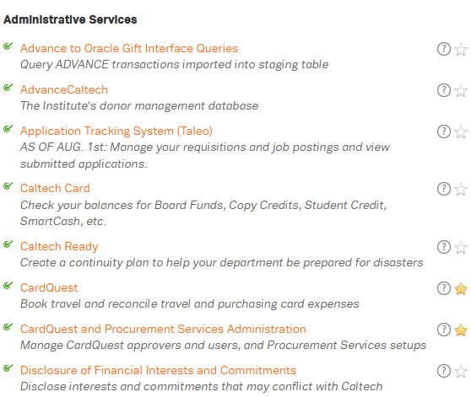

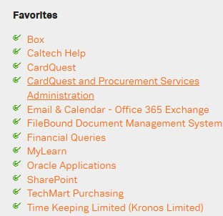


User Log In
Go to: https://access.caltech.edu
Username: access username Password: access password
Quick Tip: Short Cut
Highlight “Star” next to any software/service and it will appear under Favorites.

Slide 6
User Profiles

Slide 7



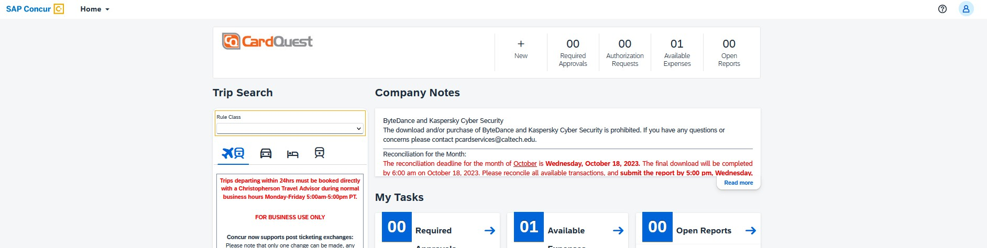
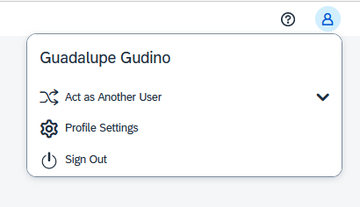
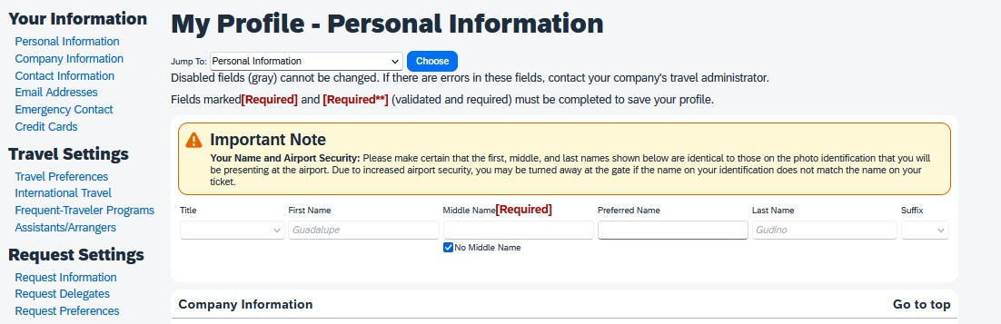


Slide 8
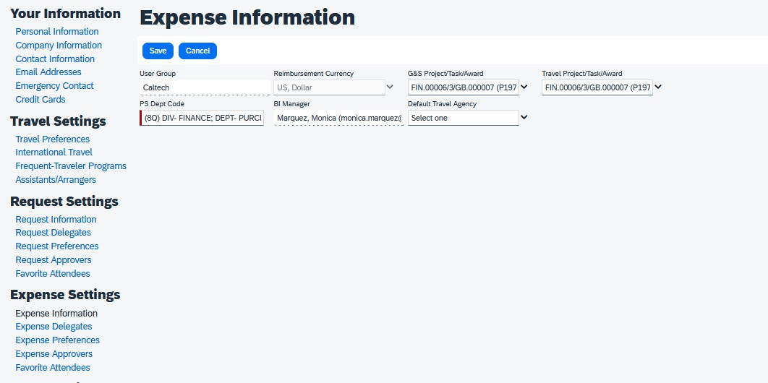
User Profile (PTA)

Slide 9
Reconciling

Slide 10
Reconciling: What we expect
Attach Receipt
A receipt is required for all Goods & Services transactions (except credits/fraudulent charges)
Define
Select Expense Type (Category)
Enter short order description and business purpose
Allocate
Select PTA and Expenditure type

Slide 11




A Transaction:
Selecting Expense Type
Adding a Business Purpose & Short Order Description
Tax

Slide 12



All transactions need a receipt, regardless of the Amount. You may upload or drop into the receipt Library/Store.
Receipts:
*Must be Legible
*Include Merchant Name
*Match exact amount of the transaction, including tax (if any)
*Include a Date
*Contain a brief description of items purchased
We Do not Accept:
Order acknowledgements Order Confirmations
E-mails Indicating No receipt was provided

Slide 13

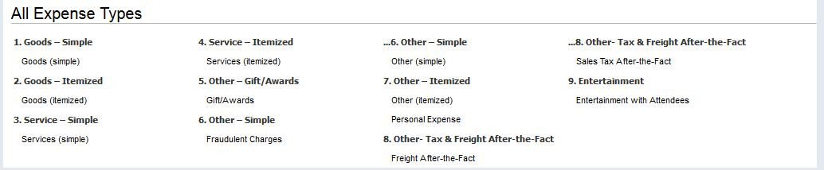
A Transaction:
Step 1. Selecting Expense Type
Expense Types:

Slide 14

A Transaction:
Simple
Lump sum entry for the total transaction amount (including tax and freight).
Transaction = 1 line
Itemized
Detailed transaction breakdown.
Items, Sales tax and freight broken out as individual lines.
Transaction = many lines

Slide 15


A Transaction:
Adding Business Purpose & Short Order Description
Be as detailed as possible for Audit purposes. Ensuring the purchases done for the benefit of Caltech.
Tax
Tax should always be added. If no sales Tax make sure you enter
$0.00 on tax line.

Slide 16


Select PTA- Will default or speak to your manager/approver/PI in what to select.
Amount or percentage you will charge PTA (or various if selected).
Expenditure Types: Oracle categories used when allocating to a PTA (ex: Supplies – Allocable)
* Please refer to the Finance training manual Finance Training Manual for guidance.

Slide 17
Now let’s Go Live and apply it all… https://www.caltech.edu/

Slide 18


Slide 19






Itemization: Z-PTA Allocation
(Dummy PTA)
Used when Itemizing an expense with Goods, Tax/Freight
TAX FREIGHT
Sales Tax - Prorated to each taxable item line(s) once the invoice has been interface into Oracle. (PTA for allocation is Z_ALLOCATE_IN_ORACLE-Z-Z for itemized lines only)
Use Tax – if an item line was not charged tax (none shown on the receipt) then Oracle will accrue the tax according to the Oracle E-BTax rules.
Caution: if you were charged tax and did not break out the amount, it will be accrued as Use tax and the PTA will be charged double the amount of tax on the item.
Prorated to each item line(s) once the invoice has been interface into Oracle. (PTA for allocation is
Z_ALLOCATE_IN_ORACLE-Z-Z for
itemized lines only)

