Slide 1
Allocation: * Allocating * Splits * Sales Tax & Freight (Z-type PTA)

Slide 2
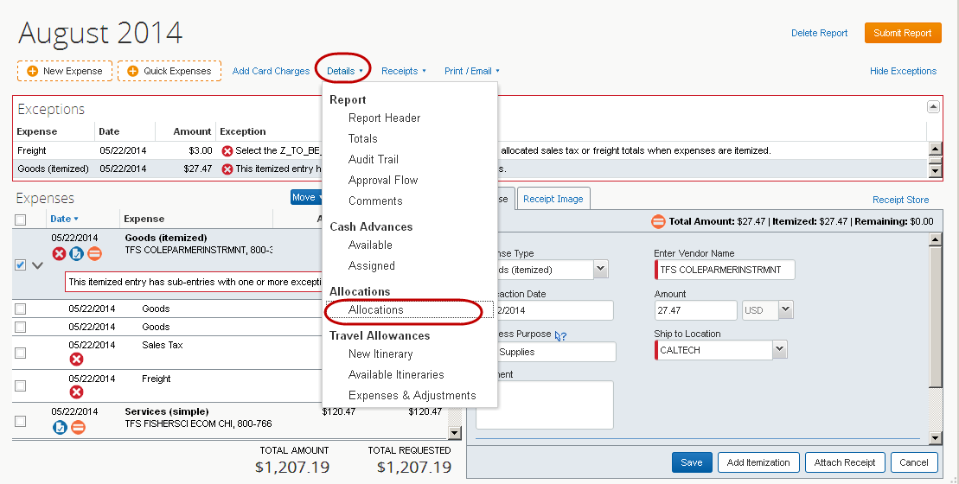
Goods & Services Expense Report Entry: Allocation

Slide 3
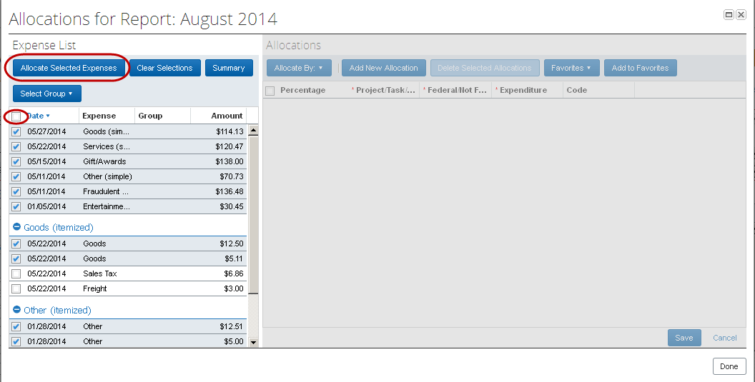
Goods & Services Expense Report Entry: Allocation

Slide 4
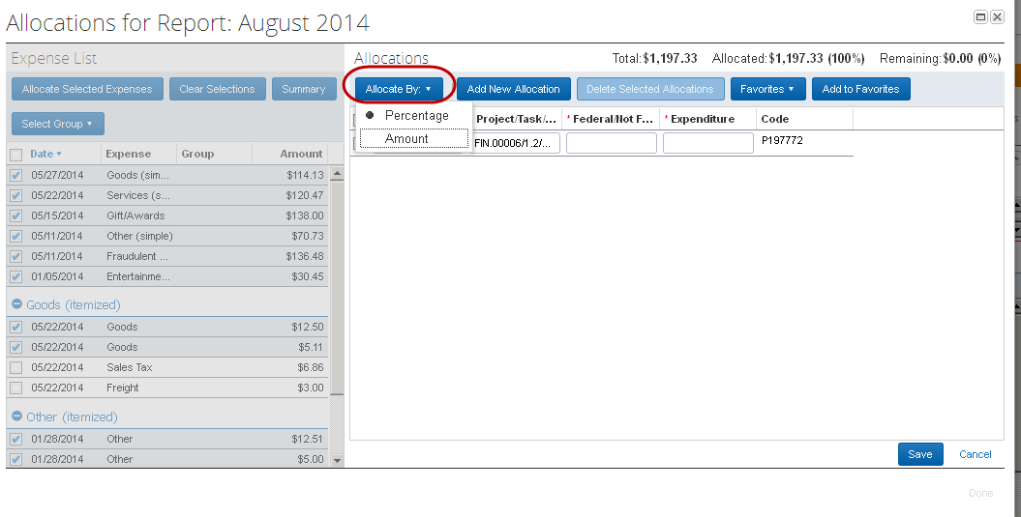
Goods & Services Expense Report Entry: Allocation Splits

Slide 5
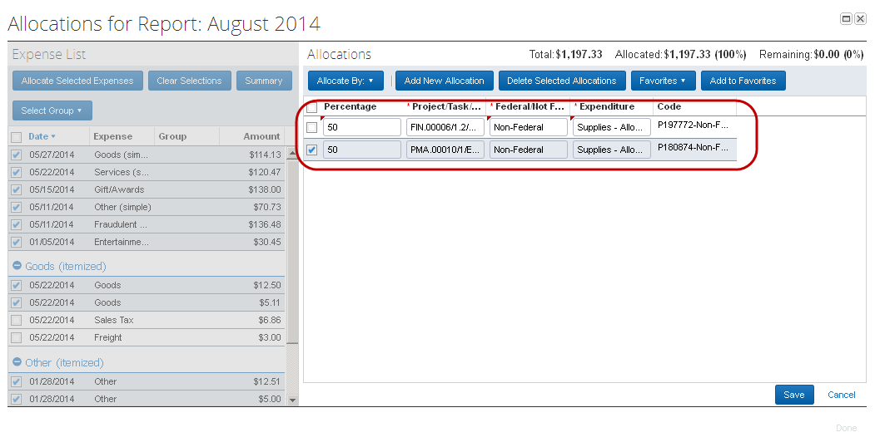
Goods & Services Expense Report Entry: Allocation Splits

Slide 6
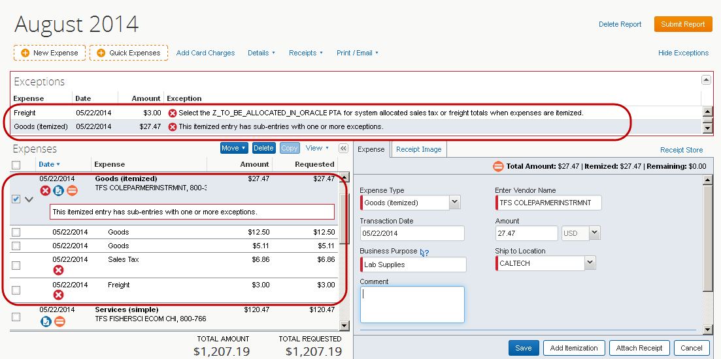
Goods & Services Expense Report Entry
Exceptions: Sales Tax and Freight

Slide 7
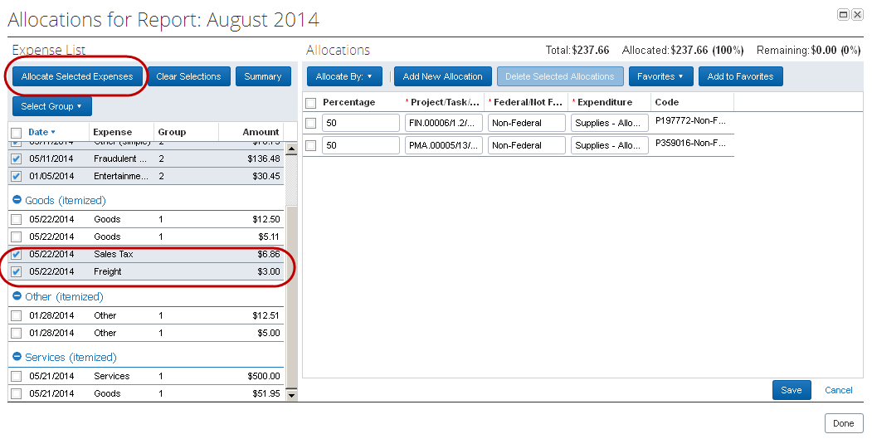
Goods & Services Expense Report Entry
Allocation: Sales Tax and Freight

Slide 8
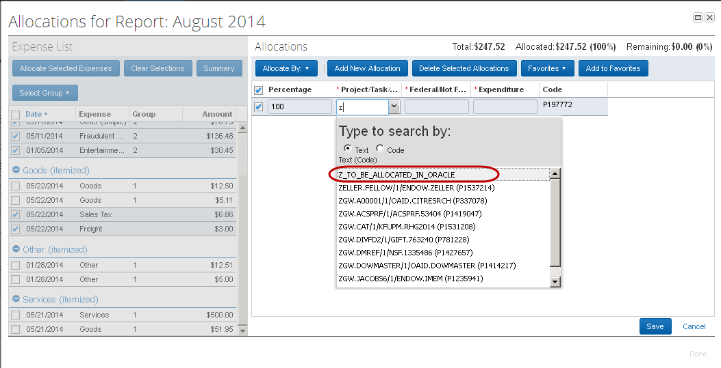
Goods & Services Expense Report Entry
Allocation: Sales Tax and Freight

Slide 9
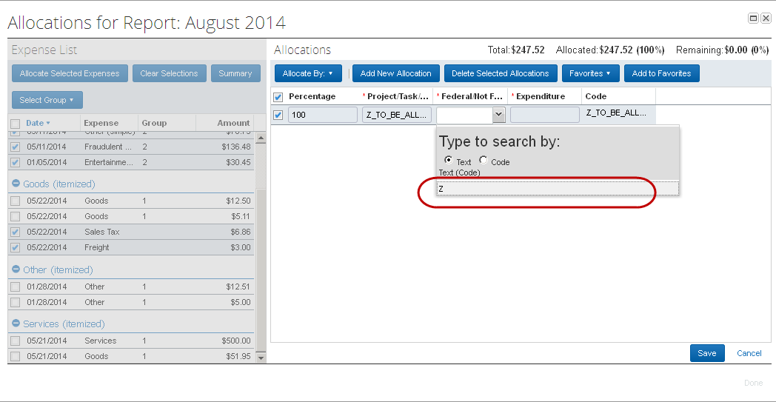
Goods & Services Expense Report Entry
Allocation: Sales Tax and Freight

Slide 10
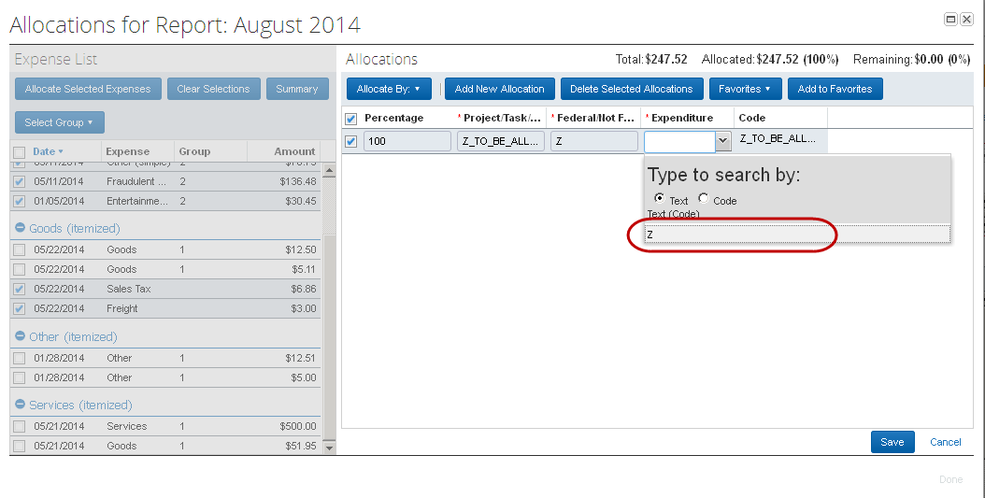
Goods & Services Expense Report Entry
Allocation: Sales Tax and Freight

Slide 11
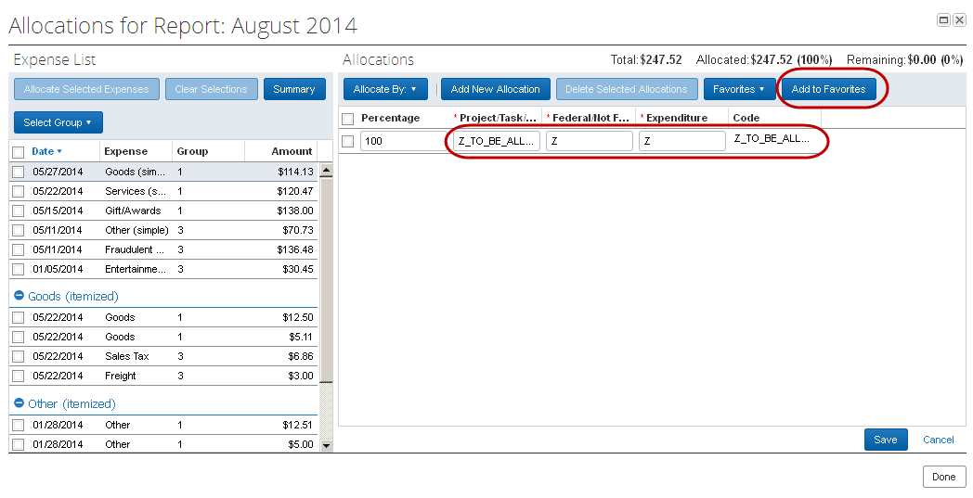
Goods & Services Expense Report Entry
Allocation: Sales Tax and Freight

Slide 12
Goods & Services Expense Report Entry
Allocation: Sales Tax and Freight

Slide 13
Contact: pcardservices@Caltech.edu for any questions or concerns on your P-Card needs (Replacement, Fraud, G&S assistance).
If you have travel concerns please contact Travel Services at TravelServices@Caltech.edu
P- Card Webpage: https://procurement.caltech.edu/p-card
You will need to log in, only accessible with Caltech Credentials
Training User Guides: https://procurement.caltech.edu/training
P-Card Policy: https://procurement.caltech.edu/documents/14080/P-Card_policy_-_U.S._Bank_7-31-20.pdf
Forms: https://procurement.caltech.edu/quick-links/quick-links-forms

