Slide 2
Purchasing
NEW USER TRAINING

Slide 3
Important Information to get Started: Logging into TechMart: Log in to www.access.caltech.edu and click on “TechMart Purchasing” under the “Administrative Services” TechMart Website: http://procurement.sites.caltech.edu/departments/techmart TechMart Help Email Address: TechMartHelp@Caltech.edu TechMart Access Form (if you are requesting access to TechMart): http://procurement.sites.caltech.edu/departments/purchasing/purchasing-forms Fill out the Access Request Form and send it to your Custodian. Custodian Listing by Division/Department: http://procurement.sites.caltech.edu/departments/purchasing/purchasing-forms/techmart-custodians-access-request-form

Slide 4
TechMart Roles & Responsibilities
TechMart Shopper: A TechMart user who can create catalog and non-catalog shopping carts. TechMart Shoppers have a zero-dollar approval limit, which means a Financial Approver must approve all shopping carts created by a TechMart Shopper. The Financial Approver is responsible for modifying the administrative details of the order, including PTA number(s).
TechMart Requisitioner: A TechMart user who can create catalog and non-catalog shopping carts. A TechMart Requisitioner may have an approval limit from zero to unlimited. A Financial Approver must approve shopping carts created above a TechMart Requisitioner's approval limit. A TechMart Requisitioner is responsible for applying the appropriate administrative details of the order, including PTA number(s), shipping address, etc.
TechMart Approver: A TechMart user who is responsible for approving a TechMart Requisitioner's shopping cart. A TechMart Approver can modify any administrative details of the order, including PTA number(s).

Slide 5
Policies & Procedures
Division/Department | Primary
Team Lead | Genelle Vinci
ASIC | Oswaldo Reategui
Athenaeum | Rudy Zepeda
B & F | Mayra Olivares
Biology | Phyllis Burton
CACR | Phyllis Burton
CCE | Mayra Olivares
DIR | Elisa Brink
EAS | Rudy Zepeda
Facilities | Chris Sierra
GPS | Oswaldo Reategui
HR | Phyllis Burton
HSS | Oswaldo Reategui
IMSS | Oswaldo Reategui
Library | Oswaldo Reategui
LIGO | Melanie McCandless
OGC | Elisa Brink
PMA | Elisa Brink
President | Phyllis Burton
Provost | Phyllis Burton
RSI | Mayra Olivares
SAS | Chris Sierra
Strategy Implementation Group | Mayra Olivares
Student Affairs | Chris Sierra
TMT | Elisa Brink
Independent Contractors Agreement | Elisa Brink, Mayra Olivares
MPA’s & RFP’s | Elisa Brink, Mayra Olivares, Oswaldo Reategui

Slide 6
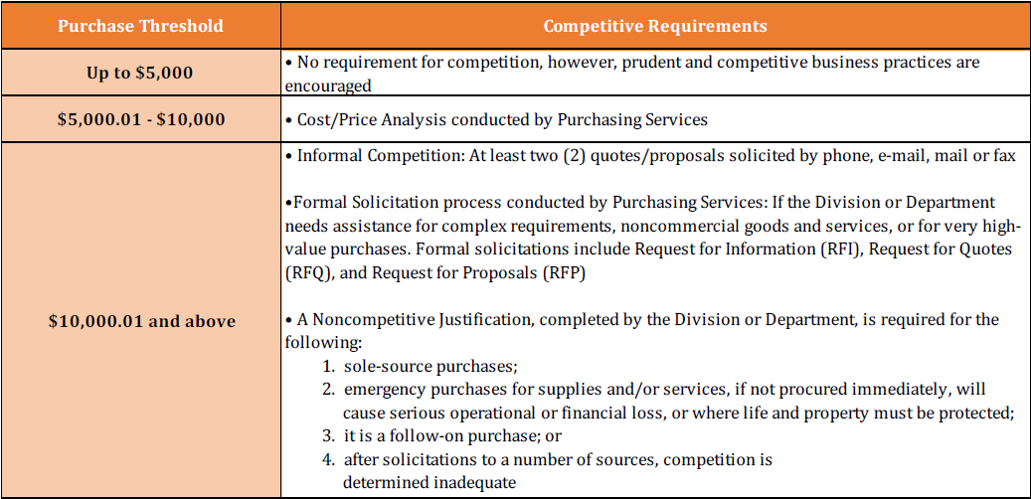
Policies & Procedures Cont’d http://procurement.sites.caltech.edu/departments/purchasing/purchasing-policies-procedures

Slide 7
Department Buyers
Division/Department | Primary
Team Lead | Genelle Vinci
ASIC | Armando Munoz
Athenaeum | Rudy Zepeda
Biology | Phyllis Burton
CACR | Rachel Fisher
CCE | Rachel Fisher
DIR | Elisa Brink
EAS | Armando Munoz
Facilities | Chris Sierra
GPS | Rudy Zepeda
HR | Rachel Fisher
HSS | Armando Munoz
IMSS | Rudy Zepeda
Library | Armando Munoz
LIGO | Eric Garcia
PMA | Elisa Brink
President | Phyllis Burton
Provost | Phyllis Burton
SAS | Chris Sierra
Strategy Implementation Group | Chris Sierra
Student Affairs | Chris Sierra
Other Assignments:
Consulting Agreements | Elisa Brink, Rachel Fisher, Chris Sierra
MPA’s & RFP’s | Elisa Brink, Rachel Fisher
Buyer Name | Phone Ext.
Armando Munoz | x2631
Elisa Brink | x4997
Chris Sierra | x4673
Phyllis Burton | x8429
Rachel Fisher | x8429
Rudy Zepeda | x2578

Slide 8
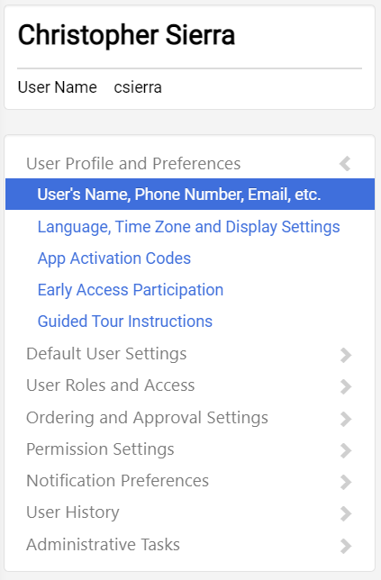
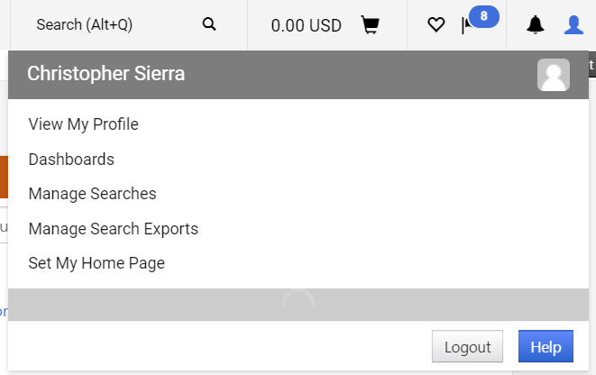
Welcome to TechMart! Now, let’s make this personal…
In TechMart, you can edit and customize your profile to meet your specific needs. In your profile, you can create Default PTA’s, view your Purchasing Limit, check Financial Approvers, customize Email Notifications, etc.

Slide 9
Profile Settings: Notification Preferences
Go to Notification Preferences and select the section you want to edit (i.e. Shopping Carts & Requisitions)
Click Edit Section
Change preferences to your specific needs
Save Changes
2.
1.

Slide 10
Profile Settings: Notification Preferences
Common Notifications for Shoppers/Requisitioners:
Requisition submitted into Workflow
Requisition Workflow complete/PO created
PO Workflow complete
Requisition rejected

Slide 11
Profile Settings: Default PTA’s
Go to Default User Settings then Custom Field and Accounting Code Defaults
Select the Codes tab
Edit PTA Default Values
2.
1.
3.

Slide 12
Profile Settings: Adding PTA’s
Your default PTA will be the value you see when creating your cart. However, you can create many values for a Project, Task, and Award. They will all appear in a drop down list of values once they are added to your profile.

Slide 13
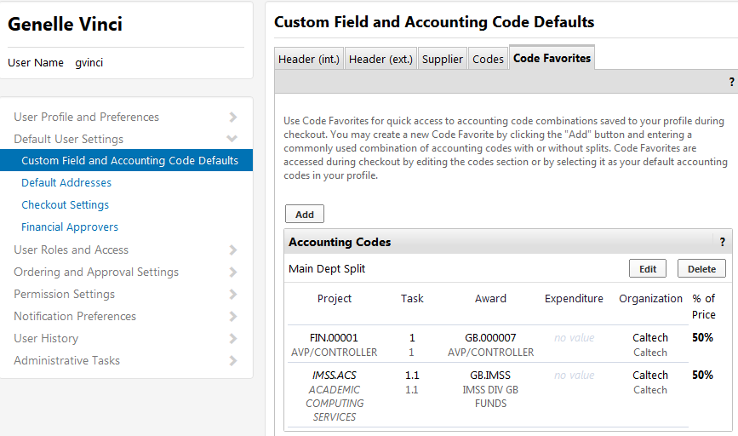
Profile Settings: Adding PTA’s
You can add Code Favorites if you know you will always have a split within the PTA’s (i.e. 50/50 split or 60/40 split). Therefore, you don’t have to manually enter the split amount each time you create a cart/requisition.

Slide 14
Profile Settings: Viewing Financial Approvers
To view your Financial Approvers:
Go to Default User Settings
Select Financial Approvers
1.
2.

Slide 15
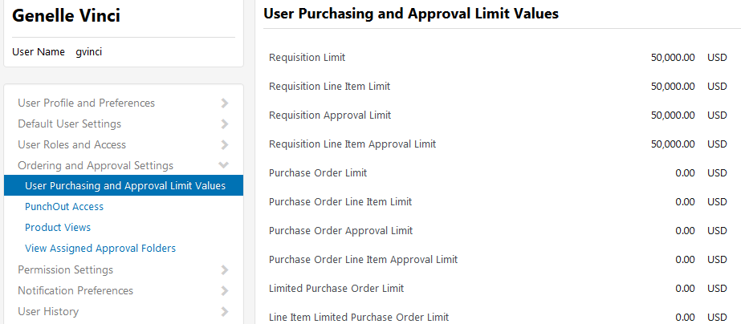
Profile Settings: Viewing Purchasing & Approval Limit Values
To view your Purchasing & Approval limits:
Go to Ordering and Approval Settings
Select User Purchasing and Approval Limit Values
1.
2.

Slide 16
Catalog Suppliers
Punchout Supplier: Suppliers that have provided a special link to their online catalog. This Punchout link is unique to Caltech, accesses the Supplier’s site that contains Caltech pricing, and then uploads the selected items from the Punchout Supplier into your TechMart Shopping Cart. To order from a Punchout Supplier, simply click on their logo and you will be directed to their catalog.
Hosted Catalog Supplier: Suppliers who have elected to provide their electronic catalog in TechMart. Suppliers have negotiated prices and terms that are advantageous to Caltech and electronically supplied their product information. To order from a Hosted Catalog Supplier, click on their logo and search for the product you are looking for.

Slide 17
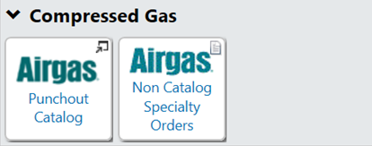
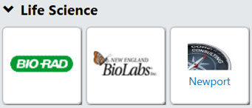
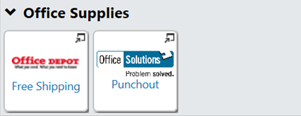
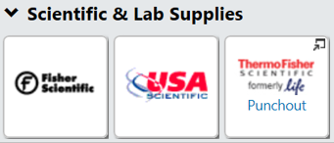
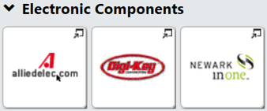
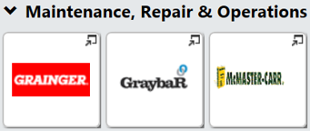
Catalog Suppliers Cont’d
Note: Punchout Suppliers will have a pop out symbol in the upper right-hand corner.
*Instructions on how to order through the Airgas Punchout:
http://procurement.sites.caltech.edu/contracted-suppliers/airgas

Slide 18
Other Ways to Order from Catalog Suppliers
Quick Order
Click on Quick Order
Enter the Supplier’s part number and select Add to Active Cart
Search the Supplier’s Catalog
Click on Suppliers
Select Click to expand Search for Supplier Filter
Select Supplier Type from the dropdown menu and Search

Slide 19
Shopping in TechMart
Punchout
Hosted Catalog
If you are searching for a product but do not have a specific vendor in mind, you can use the Shop widget located on the TechMart Homepage. A list of items from our TechMart preferred vendors will appear that have “500 mL beaker” in the line item description. From here, you can select an item and Add to Cart or select Order from Supplier, which will take you directly to that product in that supplier’s Punchout catalog.

Slide 20
Non-Catalog Suppliers
Non-Catalog Supplier: All products not contained in either the Hosted or Punchout Catalogs are Non-Catalog orders. This could be because the Supplier has elected not to participate, is not technically capable of supplying data, or the volume does not warrant inclusion. Requisitions to Non-Catalog Suppliers are initiated through TechMart and are electronically routed for approval and then on to either an SOS Buyer or a Purchasing Services Agent to be placed with the Supplier.

Slide 21
Catalog vs. Non-Catalog Orders
Non-Catalog
Order
Financial
Approver(s)
SOS or PPS
Buyer
TechMart
Shopping Cart
Supplier
TechMart
Catalog Order
Financial
Approver(s)
Punchout
Hosted Catalog

Slide 22
TechMart Forms
Change Request: Used to modify an existing Purchase Order (i.e. increase funds, change PTA, cancel PO, extend/renew existing agreement)
Compressed Gas – Airgas*: Used for new Airgas specialty gas orders that cannot be ordered through the Airgas Punchout Catalog
Declining Balance:
Declining PO – Blanket
Declining PO – Independent Contractor Services Agreement
Declining PO – Services Agreement
Research Subcontracts Declining Balance: Used for Research Subcontracts including
JPL Work Order Form Request: JPL Work Orders
Spot Buy: Used to purchase goods and materials
*Instructions on how to order using the Airgas Form: https://procurement.caltech.edu/contracted-suppliers/airgas
Must use the Ship To address called “Cylinders”

Slide 23
TechMart Forms Cont’d: Custodian Access
Partial Sales & Use Tax Exemption: Used for orders that qualify for a partial tax exemption under California Regulation 1525.4. Only “Custodians” who have completed the Partial Sales & Use Tax Exemption Training will have access to this form.
*Additional information about the Partial Sales & Use Tax Exemption:
https://procurement70.sites.caltech.edu/documents/7134/ca_partial_sales_use_tax_exemption.pdf

Slide 24
TechMart Forms Cont’d: Unauthorized Orders
Supplier After-the-Fact Request: Used for invoices that require payment and whose line items are not listed on the Payment Request Usage List*
“Invoice Attached” indicates that goods and/or services have already been rendered in the absence of a Purchase Order, and the Supplier is solely seeking payment. These are to be used on a case by case basis, for special circumstances only. It is encouraged to obtain a quote and establish a Purchase Order (Contract) prior to the Supplier providing the goods and/or services. An “Invoice Attached” does not incorporate Caltech Terms and Conditions, nor does it include insurance requirements, creating risk and liability to the Institute. Therefore, it is imperative that all transactions follow Caltech Purchasing Policies and Procedures and “Invoice Attached” transactions are avoided as much as possible.
*Link to Payment Request Usage List:
https://procurement.caltech.edu/payment-terms/payment

Slide 25
Life Cycle of a TechMart Order
Shopping Cart (Draft Requisition): The first step to ordering in TechMart involves adding items to your shopping cart (either from a Punchout/Hosted Catalog or a Form).
Shopping carts represent items selected for purchase from shoppers. They contain line items that represent goods/services being requested.
Shopper, Requisitioner, or Approver can create a Shopping Cart
Requisition: A Shopping Cart will turn into a Requisition once the “Place Order” button has been selected. This will generate a Requisition Number.
If a shopping cart exceeds your purchasing limit and requires approval from your Financial Approver, they will receive a Requisition in their TechMart queue to approve.
Requisitioner or Approver can create a Requisition

Slide 26
Life Cycle of a TechMart Order Cont’d
Purchase Order: A Purchase Order (PO) number will only be generated once the Requisition has been sent to the Supplier.
TechMart cannot issue a PO number before it is sent to the Supplier.
TechMart will assign a unique PO number once the Requisition has been approved by the Financial Approver(s) and Buyer.
This is what a complete PO number from TechMart will look like:
When referencing a PO number to the Supplier, please use the entire number i.e. “6A-S297518”, as that is what they will have in their system.
The preceding value represents the Department Code used for this order
The subsequent value represents the unique PO number automated by the system

Slide 27
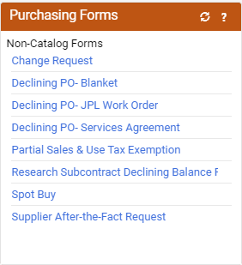
Ordering from a Non-Catalog Supplier
To place an order from a Non-Catalog Supplier:
Select the appropriate Form type under the Purchasing Forms widget on the TechMart Homepage.

Slide 28
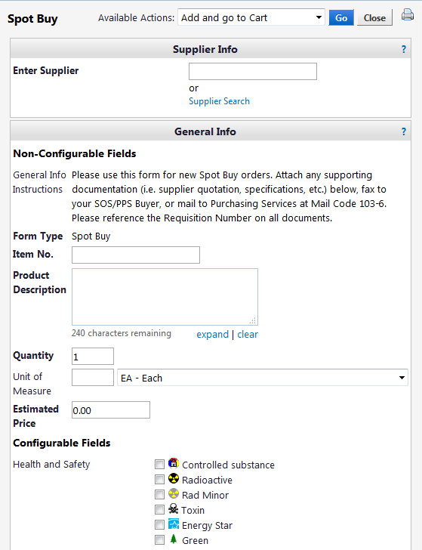
Ordering from a Non-Catalog Supplier Cont’d
Enter Supplier Name
If you see “Try Searching Again” when you type the supplier name, this means the supplier is not in the TechMart database and will need to be added. Enter and select “New Supplier” (see step 8).
Enter the Item No. if available. If not, enter “N/A”.
Enter Product Description
Enter Quantity needed for that item
Enter UOM (change as necessary)
Enter Unit Estimated Price Please use pre-tax price, as TechMart will automatically generate the tax.
2.
3.
4.
5.
6.
7.

Slide 29
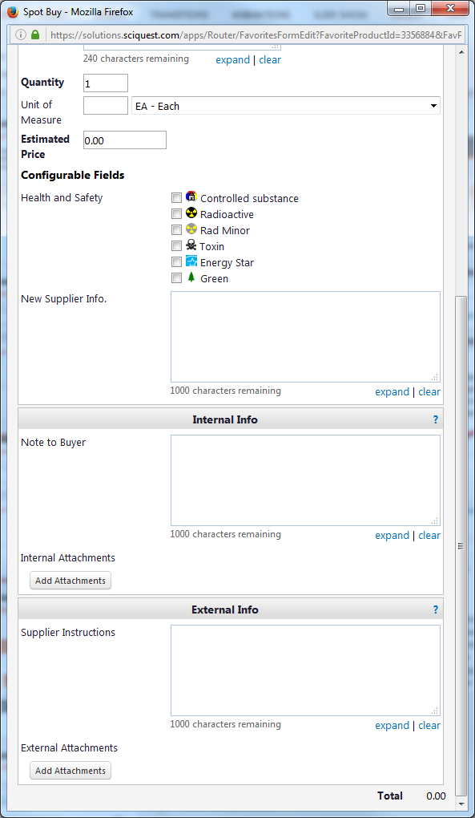
Ordering from a Non-Catalog Supplier Cont’d
Enter New Supplier Info. for suppliers not found in the system:
i.e. Supplier Name, Supplier Address, Supplier Phone and Fax, Supplier Email, Contact Person (if available)
Enter any notes/instructions for your Buyer in the Note to Buyer field
You can Add Attachments for your Buyer under Internal Attachments
i.e. Quote(s), Noncompetitive Justification (if over $10K)
Enter any notes/instructions for the Supplier in the Supplier Instructions field
You can Add Attachments for the Supplier under External Attachments
8.
9.
10.
11.
12.

Slide 30
Ordering from a Non-Catalog Supplier Cont’d
If you are only adding one item to your shopping cart, select Add and go to Cart from the Available Actions dropdown then select Go. This will redirect you to your shopping cart.
If you are adding more than one item to your cart, select Add to Cart and Return then select Go. This will bring you back to the form where you can continue adding line items as needed.
Note: You cannot mix form types in a single shopping cart (i.e. Spot Buy and Supplier After-the-Fact). You must create a cart for each form type.
13.
14.

Slide 31
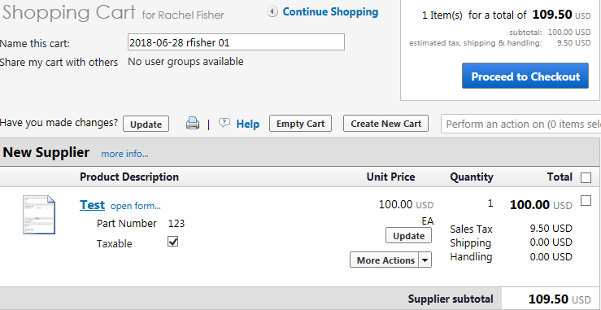
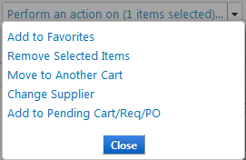
Managing Your Shopping Cart
Once you have added the item(s) you wish to purchase, you will be taken to your Active Shopping Cart. Here, you have the option to:
Name your Cart Recommended as this will make it easier to locate your purchase in the future
Add (selected items) to Favorites
Remove (selected items) from your shopping cart
Move (selected items) to Another Cart
Change Supplier
Add (selected items) to Pending Cart/Req/PO
1.
Select the line item(s) you wish to perform an action on

Slide 32
Managing Your Shopping Cart Cont’d
From here, you can Continue Shopping if you wish to add additional items to your shopping cart or you can Proceed to Checkout if your cart is complete. Your Shopping Cart will be saved in TechMart until you Proceed to Checkout or the cart is deleted.

Slide 33
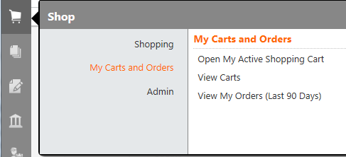
View Your Shopping Cart
To view your Shopping Cart(s):
Click on the Shop symbol from your TechMart menu bar
Select View Draft Shopping Carts
1.
2.
From here, you can (3) view which cart is Active, (4) open your Shopping Cart, or (5) delete your Shopping Cart.
5.
4.
3.

Slide 34
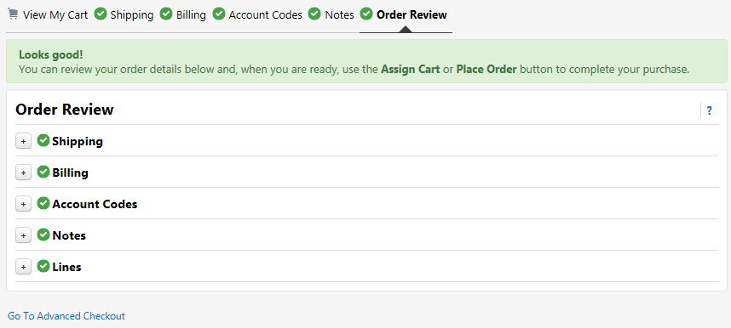
Draft Requisition
Select Go to Advanced Checkout which will take you to your draft requisition summary. This will prompt you to review each field of your draft requisition prior to placing the order.
Note: At this point, your requisition number will be generated.

Slide 35
Draft Requisition: General
The General section is where you can edit:
Cart Name
Priority For RUSH orders, change priority to “Urgent”
Description (optional)
Approver If your default approver is out for an extended period of time and will be unavailable to approve your requisition, you can select an alternate approver from your profile values.
Click Save
1.
2.
3.
5.
4.

Slide 36
Draft Requisition: Shipping
The Shipping section is where you can edit:
Ship to address
Delivery Options For RUSH orders, select “Expedite” and provide a need-by date in the “Delivery Date” field
Click Save
1.
2.
CLYINDERS

Slide 37
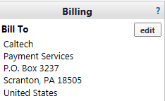
Draft Requisition: Billing & Supplier Info
The Billing section indicates on the PO to the supplier where to send their invoice. This section will never need to be modified.
The Supplier Info section should have your Default Dept. Code. If not, manually enter your Dept. Code for this order.
Please do not edit

Slide 38
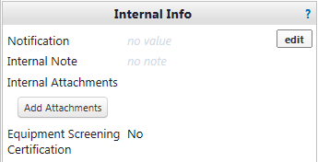
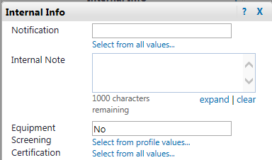
Draft Requisition: Internal Info
The Internal Info section is where you can:
Add Internal Attachments
Edit and:
Add an Internal Note Note: Internal Note & Attachments will only be viewed by Caltech personnel
3. Certify Equipment Screening Only required if all three of the following criteria are met: (1) $10K or more (2) Classified as “Equipment” (3) Federally funded Once you have completed the screening (if required), select “Yes”.
4. Click Save
*You will need to View/edit by line item if tax status varies per line (i.e. line 1 is “supplies” and line 2 is “fees”)
1.
2.
3.

Slide 39
Draft Requisition: POETA Codes
The POETA Codes section allows you to edit the PTA and Expenditure Type at the header level or View/edit by line item (line level).
If you wish to split the POETA (i.e. 50/50, 60/40), select add split and fill in the desired POETA information.
Note: You cannot split a line item using awards with different equipment title
information (i.e. Title to Caltech and Title to Government).
Header level
Line level

Slide 40
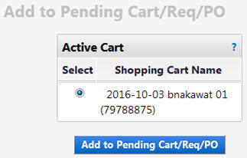
Draft Requisition: Adding Line(s)
To add a line to your requisition:
Click into the line This will reopen the form
Add product details for the additional item you want to purchase i.e. Item No., Product Description, Qty., etc.
Select Add to Pending Cart/Req/PO from the Available Actions dropdown Important: DO NOT select Save as this will change the existing line.
Click Go This will open a new window
Select the Cart or Requisition you wish to add the line to and click Add to Pending Cart/Req/PO
1.
4.
3.
5.

Slide 41
Draft Requisition: Adding Line(s) Cont’d
Now that you have successfully added a line, you will see it as a new line item on your draft requisition.
If you added a line to the incorrect requisition or need to delete a line: (1) check the box for that line item, (2) select the appropriate action from the line item dropdown (i.e. Remove Selected Items, Move to Another Cart, etc.), and (3) click Go.
2.
3.
1.

Slide 42
Draft Requisition: Place Order
Once you have reviewed your draft requisition, you should see green check marks showing that each section has been completed. If you are missing a green check mark, you will need to go into that section and complete the required information. Once everything is complete, click Place Order.

Slide 43
View Your Orders
To view your TechMart orders:
Click on the Shop symbol from your TechMart menu bar
Select View My Orders
1.
2.

Slide 44
Declining Balance PO Forms
There are 3 types of Declining Balance PO’s:
Declining PO – Blanket
Declining PO – Independent Contractor Services Agreement
Declining PO – Services Agreement
Notes:
Rachel

Slide 45
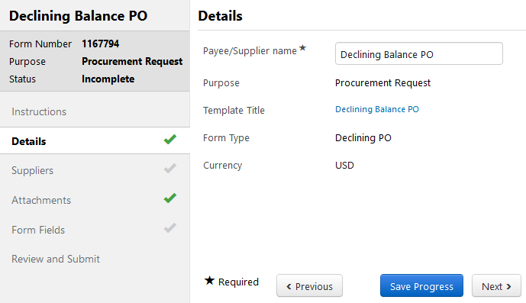
Declining Balance PO – Form Details
Change to Payee/Supplier name to “Supplier Name Declining Balance PO”
Select Next
1.
2.

Slide 46
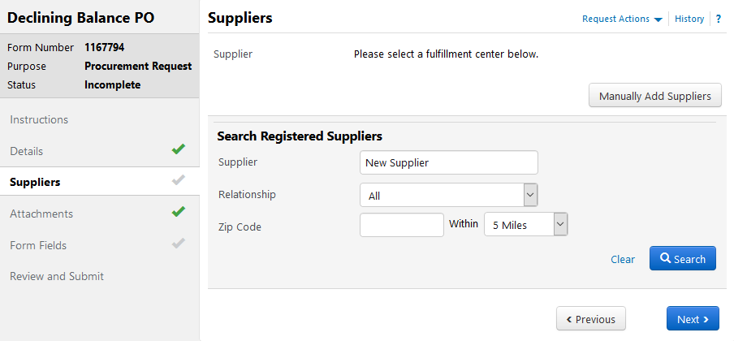
Declining Balance PO – Form Details Cont’d
Type the Supplier Name in the Supplier Field
Select Search
1.
2.

Slide 47
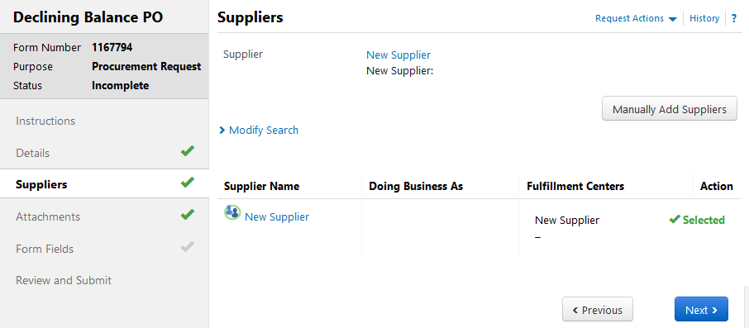
Declining Balance PO – Form Details Cont’d
Select the correct supplier and wait until the Action has changed to
Select Next
1.
2.

Slide 48
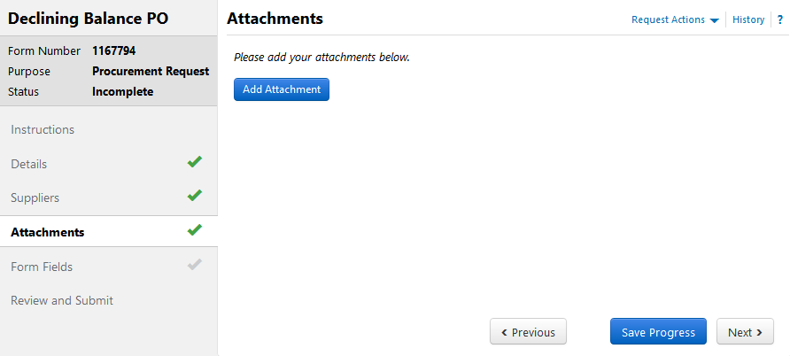
Declining Balance PO – Form Details Cont’d
Add supporting documentation; these documents will also appear in the Requisition.
Select Next
1.
2.

Slide 49
Declining PO – Blanket
A Blanket Purchase Order (BPO) is a Declining Balance PO that authorizes multiple low-dollar purchases with a Supplier over the course of one year, whereby accurate projections of specific items/quantities needed cannot be made and the issuance of multiple Spot Buy PO’s would incur unnecessary administrative costs. The purpose of a BPO is to eliminate repetitive administrative efforts by the campus requisitioner and Procurement Services by streamlining the ordering process.
Notes:
Briana

Slide 50
Declining PO – Blanket
Criteria:
All BPO's are subject to Buyer review and analysis and can be disqualified if appropriate criteria are not met.
The total Purchase Requisition amount must fund one (1) year
The PTA (account) used must be chargeable for the full year
A minimum of 2 invoices per month or 24 invoices per year must be received
The exact quantities ordered of specific items cannot be accurately projected
Requests that do not meet all of the requirements listed above must be submitted on a different TechMart form. Please contact a Purchasing Agent/Contracting Officer for further direction.
Notes:
Briana

Slide 51
Declining PO – Blanket
Justification:
Notes:
Rachel

Slide 52
Declining PO – Blanket
Renewals:
BPO’s are limited to 5 lines
BPO’s can be renewed annually for a maximum period of performance of 5 years
To renew a BPO, submit a Change Request with a signed Blanket Purchase Order Renewal Form
Upon receiving the Change Request, your Buyer will perform an evaluation of the previous year to review eligibility requirements. If the PO did not meet the requirements a different PO Form must be used.
Notes:
Rachel

Slide 53
Declining PO – Independent Contractor Services Agreement
The Declining Balance PO type used to set up a new Independent Contractor Services Agreement with an individual or sole proprietor. An Independent Contractor Services Agreement should be initiated prior to the commencement of services. If you have already been invoiced for services rendered and there will be no continuing services, the Supplier After-the-Fact form should be used in lieu of the Declining Balance PO form.
Notes:
Briana

Slide 54
Changes to Independent Contractors
California AB 5 Law: Due to the new CA Assembly Bill 5 that went into effect on January 1, 2020, the process for Independent Contractors has changed for Caltech.
CA Assembly Bill 5 presumes individuals to be employees unless Caltech can satisfy all three of the ABC questions below:
Is the individual free from Caltech’s control or direction in performing the work?
Does the work take place outside the usual course of business of Caltech?
Is the individual customarily engaged in an independent trade, occupation, profession, or established business of the work of the same nature?
Training Video: https://caltech.app.box.com/s/vnwxncike2k83nscygywepv8mbpd84t5
Training Guide: http://procurement.caltech.edu/documents/18042/IDC_Training.pdf
Notes:
Briana

Slide 55
Declining PO – Services Agreement
The Declining Balance PO type used to set up a new Services Agreement with a Supplier that has a defined fee schedule, period of performance or purchase quantities (i.e. 5-year agreement, monthly billings, equipment maintenance agreement)
Note: If you have taxable and non-taxable items on your quote, please separate them on the Form Request so taxable items and non-taxable items are on separate lines. If tax information is not clearly identified on the quote, please use one line and your Buyer will assess.
Notes:
Rachel

Slide 56
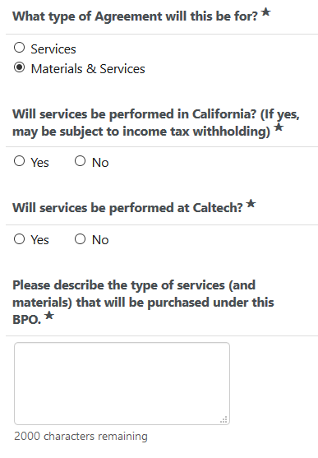
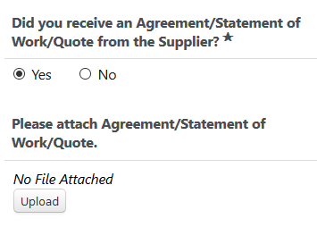
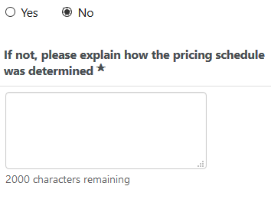
Declining PO – Services Agreement
OR, if you select “No”
Notes:
Rachel

Slide 57
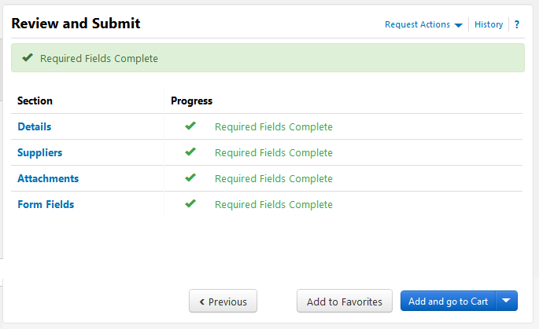
Declining Balance PO Cont’d
If all sections have a Add and go to Cart
1.

Slide 58
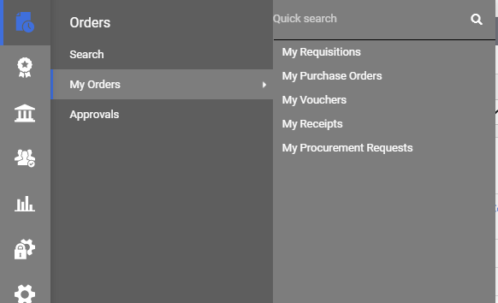
View Your Incomplete Form Requests
To view your Incomplete Form Requests:
(Declining Balance & Supplier After-the-Fact)
Click on the Orders symbol from your TechMart menu bar
Select My Orders
This will bring up all form requests that you have started but have not yet added to a cart.

Slide 59
Requisition Status
You can check status of your Requisition in the Req Approvals tab. The Active symbol represents where your Requisition is currently sitting.
You can also view the History tab for additional details.

Slide 60
What is my Purchase Order Number?
You can quickly locate your PO number from your Requisition. Once you are in the Requisition, scroll down to the bottom of the page to the Supplier / Line Item Details section. Here, you will find your PO Number.
Note: You will not see a PO Number if your Requisition is still sitting with an Approver or Buyer.

Slide 61
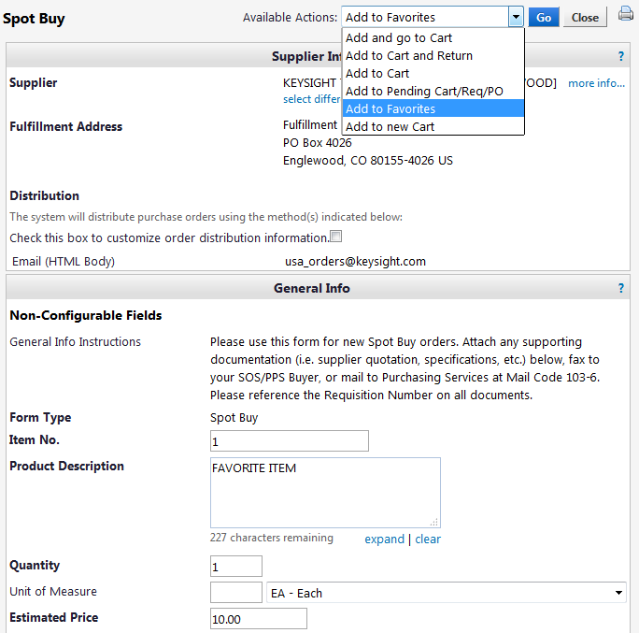
Adding Favorites
2.
3.
If you want to add a frequently purchased item to your Favorites:
Select the appropriate Form type under the Organizational Forms widget on the TechMart Homepage.
Complete the form and select Add to Favorites from the Available Actions dropdown menu.
Click Go This will open a new window

Slide 62
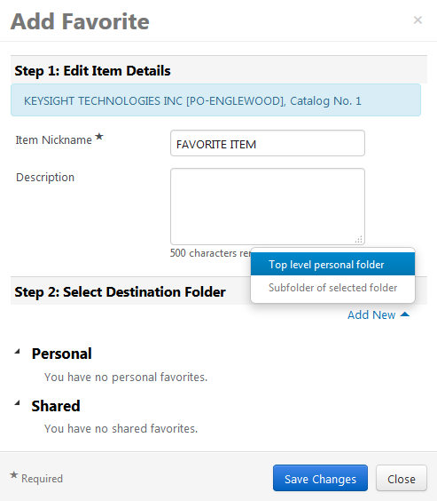
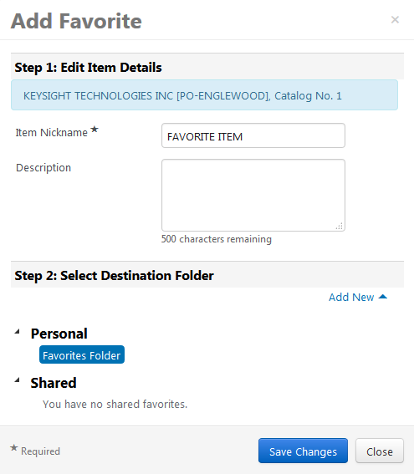
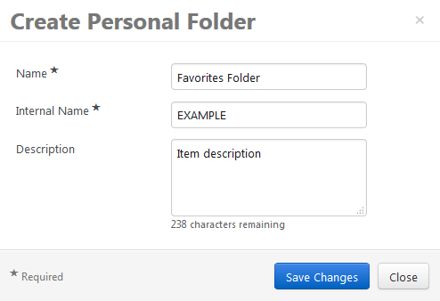
Adding Favorites Cont’d
4.
5.
3.
If you do not already have an existing Favorites destination folder, click Add New then Top level personal folder to create a folder.
You will need to name your personal folder and Save Changes.
Once your folder has been added, select your desired destination folder and Save Changes.

Slide 63
Managing Favorites
1.
To access your saved Favorites:
Click on the Favorites shortcut under the Shop widget from the TechMart Homepage.
Check the box of the item(s) you wish to perform an action on, and open the Actions for Selected Favorites dropdown. From here, you can Add to Cart, Edit, Move, Copy, or Delete.
Select View Form to make any changes to the item (i.e. update price, quantity, etc.) then select Save and Go from the available actions within the form.
2.
3.

Slide 64
2/10/21

